Slide 1
Power BI Architectural Designs
FSI CSU SWARM

Slide 2
Architectural Designs

Slide 3
Abstract and learning objectives
Understand the different types of Architectural Solutions are available for Power BI

Slide 4
Architecture Designs
Solution Architectures

Slide 5
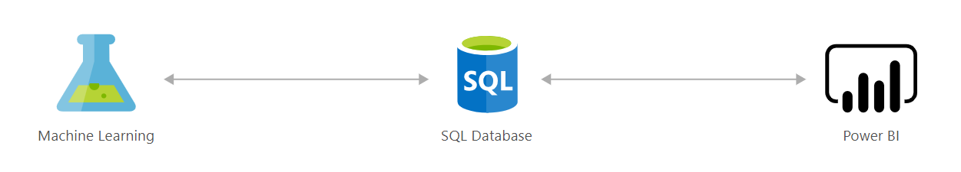
Loan credit risk analyzer and default modeling
Scoring credit risk is a complex process. Lenders carefully weigh a variety of quantitative indicators to determine the probability of default and approve the best candidates based on the information available to them.
This solution acts as a credit-risk analyzer, helping you score credit risk and manage exposure using advanced analytics models. SQL Server 2016 with R Services equips you with predictive analytics that help assess credit or loan applications and accept only those that fall above certain criteria. For example, you might use the predicted scores to help determine whether to grant a loan, then easily visualize the guidance in a Power BI Dashboard.
Data-driven credit-risk modeling reduces the number of loans offered to borrowers who are likely to default, increasing the profitability of your loan portfolio.

Slide 6
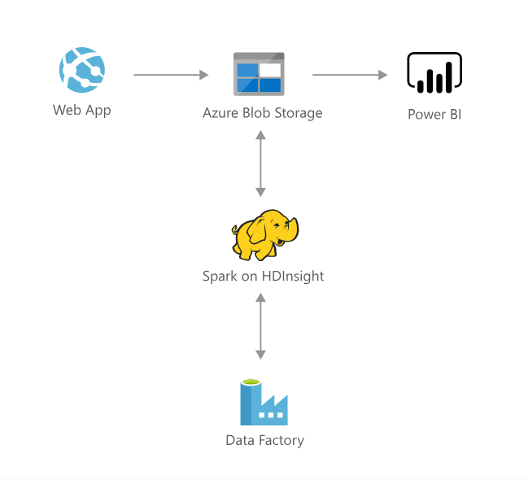
Demand Forecasting and Price Optimization
Pricing is recognized as a pivotal determinant of success in many industries and can be one of the most challenging tasks. Companies often struggle with several aspects of the pricing process, including accurately forecasting the financial impact of potential tactics, taking reasonable consideration of core business constraints, and fairly validating the executed pricing decisions. Expanding product offerings add further computational requirements to make real-time pricing decisions, compounding the difficulty of this already overwhelming task.
This solution addresses the challenges raised above by utilizing historical transaction data to train a demand forecasting model. Pricing of products in a competing group is also incorporated to predict cross-product impacts such as cannibalization. A price optimization algorithm then employs the model to forecast demand at various candidate price points and takes into account business constraints to maximize profit. The solution can be customized to analyze various pricing scenarios as long as the general data science approach remains similar.
The process described above is operationalized and deployed in the Cortana Intelligence Suite. This solution will enable companies to ingest historical transaction data, predict future demand, and obtain optimal pricing recommendations on a regular basis. As a result, the solution drives opportunities for improved profitability and reductions in time and effort allocated to pricing tasks.

Slide 7
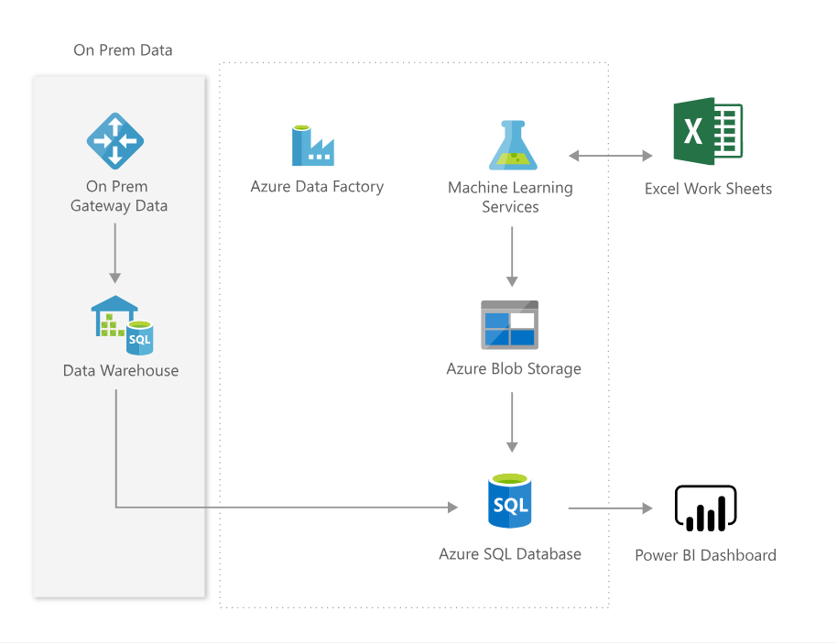
Interactive Price Analytics
The Pricing Analytics solution uses your transactional history data to show you how the demand for your products responds to the prices you offer, to recommend pricing changes, and allow you to simulate how changes in price would affect your demand, at a fine granularity.
The solution provides a dashboard, where you can see optimal pricing recommendations, item elasticities at a item-site-channel-segment level, estimates of related-product effects such "as cannibalization", forecasts given current process, and model performance metrics.
Direct interaction with the pricing model in Excel lets you simply paste your sales data there and analyze your prices without the need to integrate the data into the solution database first, simulate promotions and plot demand curves (showing demand response to price), and access dashboard data in numerical form.
The rich functionality is not confined to Excel. It is driven by web services that you, or your implementation partner, can call directly from your business applications, integrating price analysis into your business applications.

Slide 8
Wrap Up

